Slide 1
Midway Capstone: AFCARS
Connor Williams

Slide 2
My Interest
Human Services Research and Evaluation
Problem: Analysis of Foster Care records
Intramural Research Project
What can entry variables tell us about chances for good outcomes?

Slide 3
AFCARS Data
Administrative Data
Collected Yearly until 2010, 6 month from there
Unique Child Identifiers
Demographics, Reason for Removal from Home
Good outcomes = Exiting Foster Care
Also NYTD outcomes, may not look at these

Slide 4
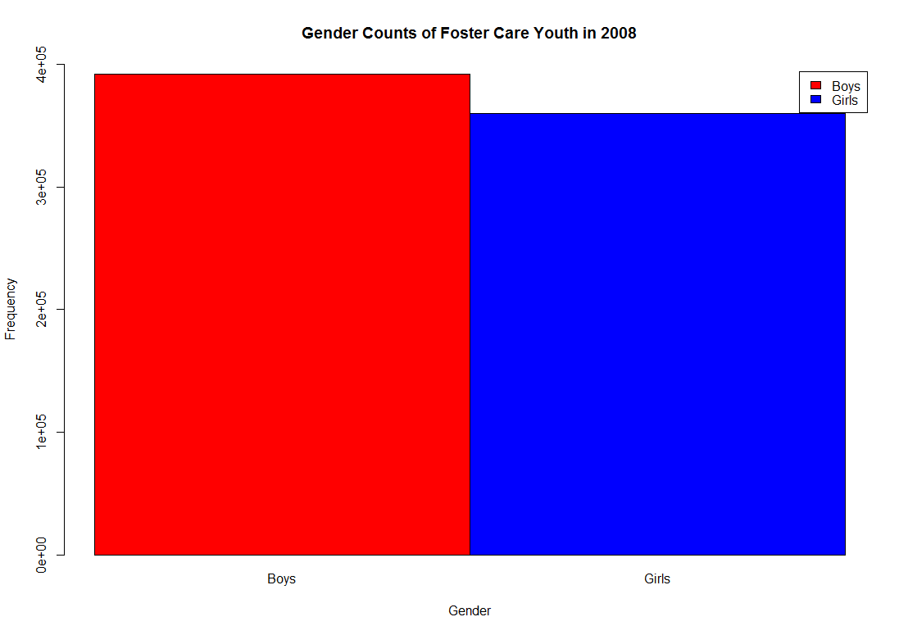
Gender Breakdown

Slide 5
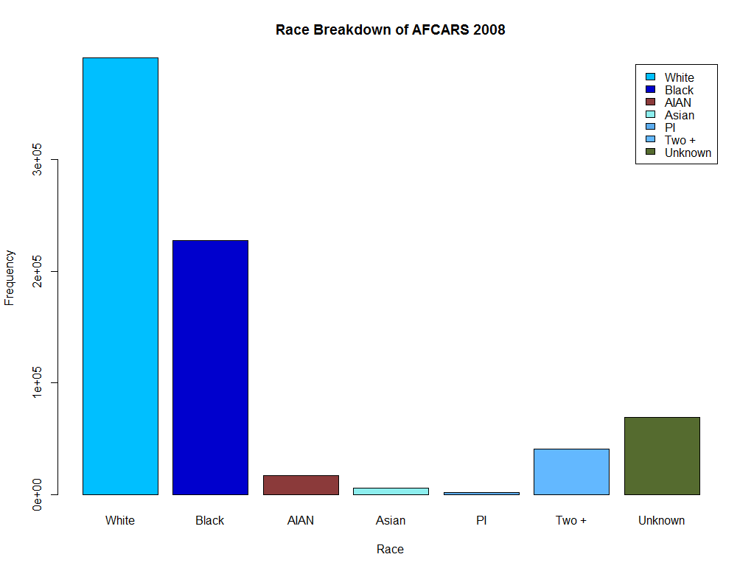
Race Breakdown

Slide 6
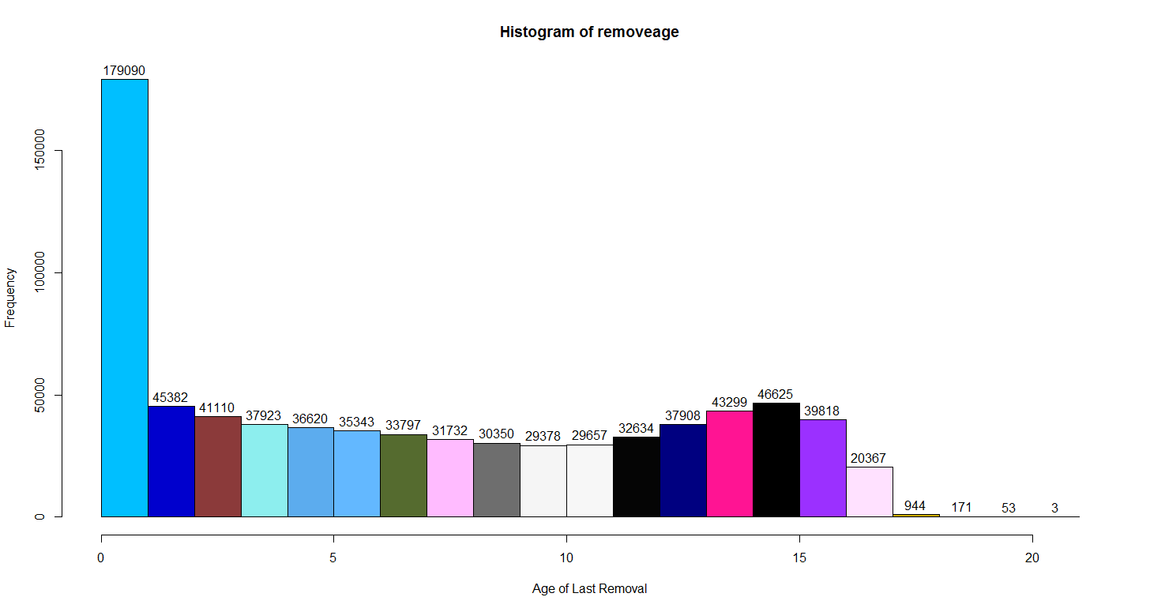
Age of Last Removal from Home

